Slide 1
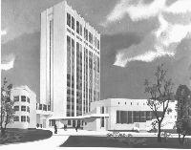

Distinct mechanisms of signal processing by lamina I spino-parabrachial neurons
Pavel Belan
Bogomoletz Institute of Physiology
Kyiv, Ukraine
Kyiv, Ukraine
October 1, 2019

Slide 2
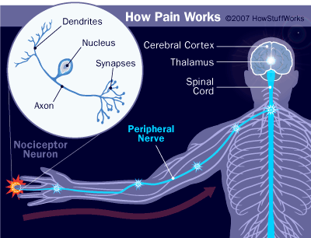
Pain processing pathways
Notes:
Studies of general principles of pain processing are very important for better understanding both the physiology of nociception and pathology of pain syndromes. It is well-known that somatic painful stimuli induce action potential in peripheral receptors of dorsal root ganglion neurons. These APs propagate to the spinal cord resulting in its activity further transduced to supraspinal structures and finally to the cortex where the emotion of pain is formed. In our work we have centered on a better understanding of encoding peripheral afferent input from the DRG neurons into spinal cord output to the supraspinal centers.

Slide 3
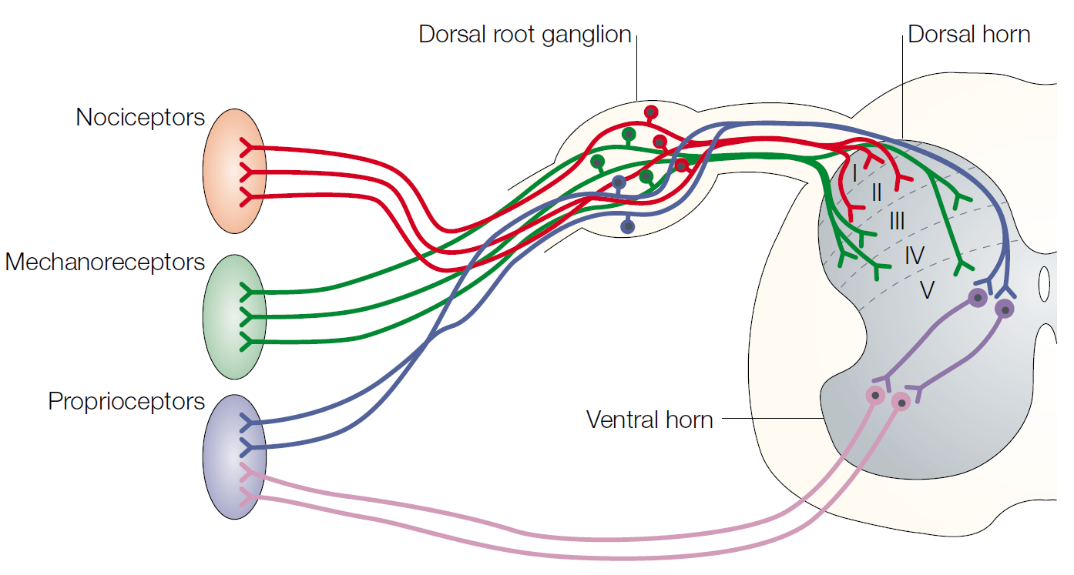
Organization of the PNS and spinal cord
NATURE REVIEWS NEUROSCIENCE, VOLUME 4, 2003, 289
Notes:
I would like to briefly remind you that the axons of sensory neurons project from the dorsal root ganglia to
specific laminae in the dorsal horn of the spinal cord. Pain and temperature are sensed by
nociceptive neurons (red), and their messages are conveyed to laminae I and II. Touch is mediated by
mechanoreceptors (green) in the periphery, which connect to laminae III, IV and V.
Figure 1 |
Organization of the spinal cord.
Schematic of neuronal circuits in a mouse spinal
cord at embryonic day 18. The axons of sensory neurons project from the dorsal root ganglia to
specific laminae in the dorsal horn and to the periphery. Pain and temperature are sensed by
nociceptive neurons (red), and the messages are conveyed to laminae I and II. Touch is mediated by
mechanoreceptors (green) in the periphery, which connect to laminae III, IV and V. Proprioception
is mediated by the sensory neurons that project through the dorsal horn to the ventrally located
motor neurons (shown in blue) The motor neurons also connect directly back to the muscle in the
periphery to drive movement (pink). Roman numerals indicate the laminae of the dorsal horn

Slide 4
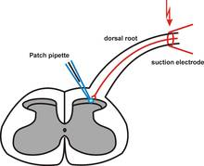
Electrophysiological recordings from Dorsal Horn
Notes:
For decades, spinal cord slices with attached dorsal roots have been the main experimental preparation to study pain processing in the dorsal horn networks. However, this reduced preparation has strong limitations in studies of superficial projection neurons.

Slide 5
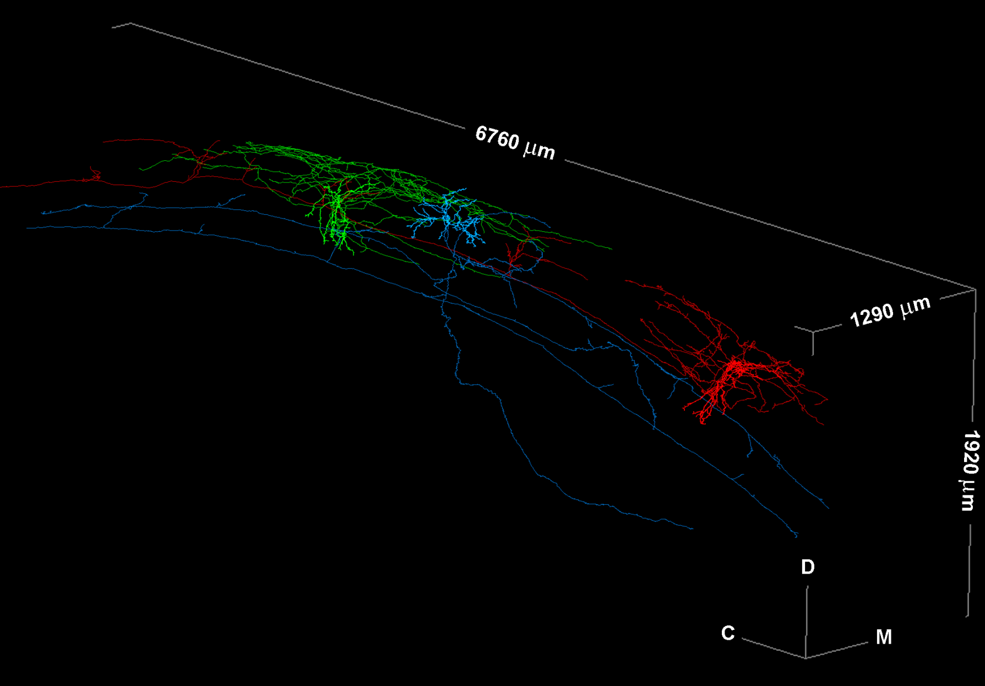
Axons of lamina I local-circuit neurons (LCNs) & projection neurons (ALT-PN)
LCN
LCN
ALT-PN
Safronov lab results
Notes:
As you can see from these morphological reconstructions of local and projection spinal cord neurons each cell in such preparation will be damaged by slice cutting procedure having in mind that a thickness of the slices is about 300 um. Besides, network connectivity as well as dorsal root axons are also not preserved.
The majority are the multipolar (with ventrally protruding dendrites) and flattened (dendrites limited to lamina I) somatodendritic categories. The initial myelinated part of the axon gives rise to several unmyelinated small-diameter branches that have a high number of densely packed, large varicosities and an extensive rostrocaudal (2-3 segments), mediolateral, and dorsoventral (reaching laminae III–IV) distribution. The extent of the axon and the occasional presence of long, solitary branches suggest that LCNs may also form short and long propriospinal
connections.
3-D reconstruction of two LCNs and a mixed-collateral-type (MCT) ALT-PN, filled in the same spinal cord.

Slide 6


Cell imaging in the spinal cord
IR LED Illumination
DIC Reflected
IR-LED
DIC Transmitted
Notes:
To overcome these problems we have employed so called IR LED illumination introduced several years ago by Boris Safronov and Victor Derkach. In this approach the light is supplied from the top rather than from beneath of the preparation as it had been used in the most widely used DIC approach. It allowed us to easily observe cells in the superficial 100 um of the spinal cord and to conduct electrophysilogical patch clamp recordings from these cells.

Slide 7
The superficial dorsal horn (laminae I-II)
Aβ
Sensory
pathways
Aδ
ALT
LI
C
LII
Nociceptive
pathways
Aβ
Sensory
pathways
Notes:
In this lecture I will center on the specific class of superficial dorsal horn nociceptive neurons that is called ‘projection neurons’. These are the neurons that receive nociceptive afferent inputs, can be modulated by other sensory pathways, interact with spinal cord interneurons and ultimately transmit nociceptive messages to the brain via an anterolateral tract, thus far being a main pathway ‘informing’ the brain about peripheral painful stimuli.

Slide 8
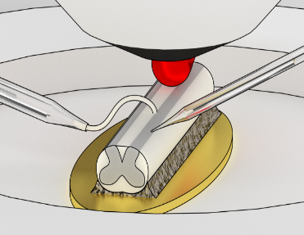
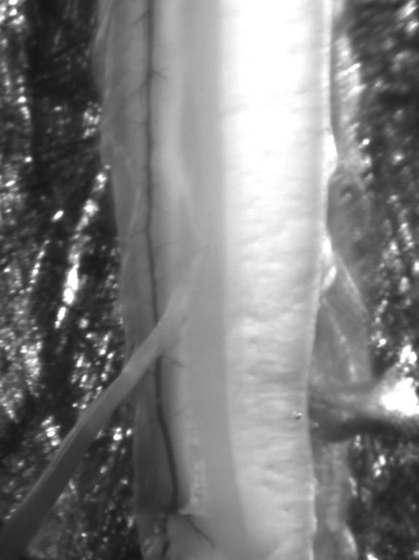
Visualization of lamina I neurons using infrared light-emitting diode (IR LED) illumination in the ex-vivo spinal cord preparation
1 mm
C
D
Notes:
Fig.3. Visualization of lamina I neurons using infrared light-emitting diode (IR LED) illumination in the ex-vivo spinal cord preparation. A. Optical part of the setup including an upright microscope, an IR LED mounted on a micromanipulator and a 3D-printed bath chamber. B. The ex-vivo spinal cord glued to a golden plate (yellow) and illuminated by the IR LED (red). The scattered IR illumination is collected by the objective for the cell visualization. The dorsal root stimulating and the cell recording electrodes are located on the left and right sides of the preparation. The intact spinal cord preparation with the attached L5 dorsal root (C) and the superficial DH neurons (D).

Slide 9
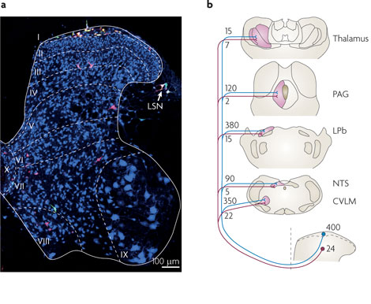
Projection neurons of spinal cord
Nature Reviews Neuroscience 11, 823-836
Notes:
Spinal lamina I projection neurons (PNs) play important role in nociception relaying peripheral Aδ and C afferent inputs to the supraspinal centers generating sensation of pain. Their ascending axons target specific brainstem and thalamic nuclei (), which further project to the nociceptive processing areas in the amygdala, hypothalamus and primary somatosensory cortex. Thus, lamina I PNs give rise to the ascending pathways encoding emotional as well as discriminative aspects of pain.
Unfortunately, little is known about how these PNs encode different aspects of nociceptive information. A number of recent studies began to throw light on the dorsal horn circuitries processing specific modalities of sensory input, i.e. itch or mechanical pain (100 Ref), but it is still not clear how the major output elements of the spinal network encode detection and intensity of noxious stimuli. This knowledge of general principles of signal encoding, however, is necessary for better understanding both the physiology of nociception and pathology of pain syndromes.
a | This image shows a transverse section through the contralateral side of the fourth lumbar segment of the spinal cord (L4) of a rat that received injections of two retrograde tracers: Fluorogold into the lateral parabrachial area (LPb) and cholera toxin B subunit (CTb) into the caudal ventrolateral medulla (CVLM). The section was immunostained for CTb (shown in red), Fluorogold (shown in green) and NeuN (shown in blue). Injection of tracers into both of these regions has previously been shown to label virtually all lamina I projection neurons⁵⁹. Cells retrogradely labelled from the LPb appear green, those labelled from the CVLM are red, and those that received label from both sites are yellow. Note that there is a high density of double-labelled cells in lamina I, but that even here they are outnumbered by other neurons (shown in blue). Lamina II contains virtually no projection cells at lumbar levels, and there are scattered retrogradely labelled cells in deeper laminae and in the lateral spinal nucleus (LSN). b | A summary of quantitative data from a series of studies of projection neurons in the L4 segment of the rat spinal cord^{58, 59, 65, 66, 67}. These data suggest that there are approximately 400 projection neurons in lamina I (~5% of the total neuronal population in this lamina)¹¹⁶ (bottom right). Most of these can be retrogradely labelled (indicated by the blue lines) following injection of tracer into the LPb or CVLM, with smaller numbers projecting to the other sites. Studies involving paired injections indicate that virtually all lamina I cells that are retrogradely labelled following tracer injection into the thalamus, periaqueductal grey matter (PAG) or nucleus of the solitary tract (NTS) also project to LPb. Note that as spinal projections to the CVLM terminate near the main bundle of ascending axons, retrograde labelling from this region may include cells labelled through uptake of tracer into fibres of passage, rather than from axon terminals. The numbers of neurokinin 1 receptor (NK1R)-expressing projection neurons in lamina III and lamina IV that can be labelled from each site are also shown (indicated by the numbers along the red lines). There are around 24 of these cells per side in the L4 segment (corresponding to ~0.1% of the neurons in this lamina¹¹⁶). c | A horizontal section through lamina I scanned to reveal NK1R (shown in green) and the glycine receptor-associated protein gephyrin (shown in magenta). Two NK1R-positive neurons and a giant lamina I cell (outlined by gephyrin puncta) are visible. Although retrograde labelling was not performed, all lamina I neurons of this size are known to be projection cells^{46, 83}. d | An example of an NK1R-expressing lamina III projection neuron in a sagittal section. The cell is retrogradely labelled with CTb (shown in magenta) that had been injected into the LPb. Note the extensive dorsal dendrites that are labelled with the NK1R antibody (shown in green) and can be followed into lamina I. Several retrogradely labelled lamina I cells are also visible in this field. Part a is reproduced, with permission, from Ref. 158 © (2006) Elsevier. Part c is reproduced, with permission, from Ref. 82 © (2008) Society for Neuroscience. Part d is reproduced, with permission, from Ref. 59 © (2000) Wiley.

Slide 10
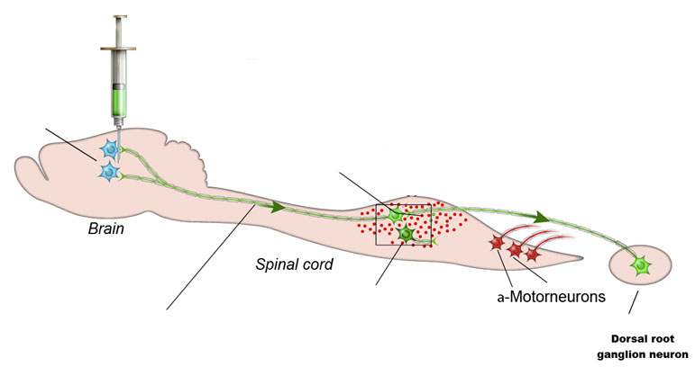
Retrograde labeling of nociceptive projection
spinal cord neurons by injection in parabrachial area
Fluorogold (FG)
AAV9-GFP
Parabrachial area
Lumbar lamina I PNs
Interneurons
Retrograde transport of
FG or AAV9-GFP to soma of lumbar PNs

Slide 11
Schematic illustration of experimental design and projection neuron labeling

Slide 12
High output projection neurons as main output of spinal cord
Notes:
Based on their responses to the dorsal root stimulation at saturating strengths (1 ms, 100-150 µA, 10 pulses at 0.1 Hz), PNs could be divided in three groups. The largest group (n = 36) contained low-output PNs (LO-PNs) generating short-duration EPSPs and on average one spike (Fig. 1Ca and Da). The medium-output PNs (MO-PNs, n = 11) responded with bursts of three-to-six spikes (Fig. 1Cb and Da). Principally different type of response was observed in a group of high-output PNs (HO-PNs, n = 11), where large-amplitude and long-duration EPSPs evoked firing of ten-to-twenty spikes (Fig. 1Cc and Da). Counting the total number of action potentials revealed that HO-PNs, which represented only 19% of the PN population, generated 69% of its output spiking activity (Fig. 1Db). Thus, different responses of LO-PNs, MO-PNs and HO-PNs to saturating stimulations imply their specific roles in nociceptive processing.
Ca-c, characteristic discharges evoked by the dorsal root stimulation (1 ms, 100 µA) in a low-output PN (LO-PN), in a medium-output PN (MO-PN) and in a high-output PN (HO-PN). Here and in the following figures, the time moments of the stimulations are indicated by arrows. Da: the histogram showing distribution of PNs according to the number of spikes they fire in response to the dorsal root stimulation. Da: a total number of spikes evoked in the populations of LO-PNs, MO-PNs and HO-PNs by the dorsal root stimulation.

Slide 13
LO-PNs and HO-PNs are different pain encoders
LO-PNs
HO-PNs
MO-PNs
Notes:
Aa-c, spike discharges evoked in LO-PNs, MO-PNs and HO-PNs by gradually stimulating dorsal roots. The strength of the current pulse is indicated near to the corresponding trace; open and filled arrows indicate 50 µs and 1 ms pulses, respectively.
Three groups of PNs showed principally different input-output characteristics in experiments where dorsal roots were gradually stimulated to recruit Aδ (50 µs pulses, 0.1 Hz) and C (1 ms pulses, 0.1 Hz) fibers.
LO-PNs had firing threshold in the nociceptive C fiber range (1 ms, 30-70 µA) and did not show more than one or, rarely, two spikes, even at the strongest stimulations tested (Fig. 2Aa, 1.15 ± 0.04 spikes, n = 36). Therefore, the LO-PNs demonstrated properties of a detector of a high-threshold nociceptive input.
In contrast to the other two groups, the MO-PNs exhibited heterogeneous input-output characteristics. In four cases, the neurons showed properties of Aδ nociceptors, in which a short discharge was evoked by the Aδ fiber stimulations, and the number of spikes did not increase in the C fiber range (Fig. 2Ab). The remaining 7 neurons displayed unique characteristics and, due to such a diversity, the MO-PNs were not analyzed further.
HO-PNs began to discharge at the nociceptive Aδ stimulations (50 µs, 60-70 µA) and the number of evoked spikes increased in the C fiber range (Fig. 2Ac). The HO-PNs showed characteristics of nociceptive neurons with a wide-encoding-range.

Slide 14
LO-PNs and HO-PNs are different pain encoders
Notes:
Ba, the input-output characteristics of the LO-PNs and HO-PNs. Each point represents the mean number of spikes evoked in each type of neuron at a given intensity of the dorsal root stimulation. An inset shows recruiting of the nociceptive C fibers studied by recording compound action potentials (CAPs) in the isolated dorsal roots (n = 5). The response was measured by integrating the area under the curve. Bb, the relative contribution of the LO-PNs, MO-PNs and HO-PNs to the total number of spikes generated by the entire population of PNs as a function of the stimulation strength in the C fiber range (1 ms).
The difference in the encoding properties of LO-PNs and HO-PNs became evident when comparing plots of their input-output characteristics (Fig. 2Ba). That for the LO-PNs was simple and could be well fitted in the C fiber range with a Boltzmann function reaching its saturation at a value close to one spike (1.15, R²=0.99). Thus, the LO-PNs were likely to signal detection of the nociceptive C fiber input using a single spike code. The characteristic for the HO-PNs first showed a local saturation in the Aδ fiber range (at 60-70 µA) but then grew linearly at C fiber stimulations (slope, 1 spike per 12 µA; t-value, 13.02; p < 0.001). This way, the HO-PNs could detect the nociceptive Aδ input by firing a short burst of spikes and encode the strength of the C fiber input by generating an increasing number of spikes after the initial burst. The present data indicated distinct functional roles of these PNs. From a physiological point of view, the LO-PNs detected the high-threshold nociceptive input, while the HO-PNs were able to encode its strength.
The contribution of the HO-PNs (n = 11) to the total number of spikes generated by the entire population of PNs (n = 58) in the C fiber range increased from 51% at 30 µA to 69% at 130 µA (Fig. 2Bb). Surprisingly, the number of spikes in HO-PNs continued to increase in the range where the C fiber activation, measured by recording compound action potentials (CAPs) in isolated dorsal roots, reached its saturation (Fig. 2Ba). Since this effect was not seen in LO-PNs, we assumed that a specific sensitization of the local circuitries could play a significant role in exciting HO-PNs. In the following experiments, we studied mechanisms of the cell-type specific encoding in LO-PNs and HO-PNs.

Slide 15
LO-PNs and HO-PNs differ in their intrinsic properties
Notes:
Figure 3. Intrinsic firing properties of LO-PNs and HO-PNs
A, intrinsic firing in a tonic PN, a delayed PN and a bursting PN elicited by the intracellular current injection (pulse duration, 500 ms). In the bursting PN, short bursts of spikes were also evoked in an all-or-nothing manner by the intracellular injection of a short (10 ms) current pulse (right). B, diagrams showing percentage of LO-PNs and HO-PNs among tonic, delayed and bursting neurons.
LO-PNs showed tonic (n = 20), delayed (n = 12) and bursting (n = 6) patterns of intrinsic firing, while HO-PNs were tonic (n = 4) and bursting (n = 7) (Fig. 3). In the last group, bursts of two-to-four spikes were also evoked in an all-or-nothing manner by short current injections (Fig. 3) or spontaneous synaptic activity (not shown). Statistical tests revealed a significant difference in the firing patterns of these PNs (p < 0.01, Fisher’s exact test). The HO-PNs had significantly higher proportion of bursting neurons (3.8 times, p < 0.01, Bonferoni post-hoc test), which responded to suprathreshold afferent stimulations with a short burst of spikes. Thus, intrinsic firing properties provide a partial explanation for the higher number of spikes evoked in HO-PNs in comparison with LO-PNs. Furthermore, intrinsic all-or-nothing bursts of spikes in HO-PNs were responsible for the detection of the nociceptive Aδ input as well as its local saturation in the Aδ stimulation range (Fig. 2Ba).

Slide 16
LO-PNs and HO-PNs differ in their afferent supply
Notes:
A detailed analysis of the primary afferent input revealed a clear difference in the organization of their afferent supply.
The number of all monosynaptic inputs per neuron in the population of HO-PNs was 2.2 times higher than in LO-PNs (p < 0.001, unpaired t-test, Fig. 4A and Ba). More specifically, HO-PNs received higher number of direct inputs from Aδ (2.6 times, p < 0.01, unpaired t-test), LT-C (5.1 times, p = 0.02, unpaired t-test) as well as C (1.6 times, p = 0.3, unpaired t-test) afferents (Fig. 4Ba).
There was also a significant difference in a percentage of PNs receiving each type of input (Fig. 4Bb). Although all PNs in our sample were directly supplied by C fibers, substantially higher percentage of HO-PNs received monosynaptic Aδ and high threshold Aδ inputs (90.9% versus 46.7% for LO-PNs, p = 0.014, Fisher’s exact test). Furthermore, more than a half of HO-PNs (54.5%) received at least one LT-C fiber input, whereas LO-PNs were almost deprived of it (6.7%, p = 0.002, Fisher’s exact test).
To estimate the strength of the primary afferent input (both mono- and polysynaptic), we calculated area under the curve for the major EPSC component. At maximum C fiber stimulations, the inputs to the HO-PNs were 5.5 times stronger than those to the LO-PNs (Fig. 4C; p < 0.05, unpaired t-test). Since the difference in the strength was substantially larger than that in the average number of direct inputs to PNs (2.2 times), one could assume that HO-PNs also received a stronger polysynaptic input.
Thus, HO-PNs receive more direct inputs from the nociceptive fibers and their overall primary afferent supply is substantially stronger than in LO-PNs. Higher number of Aδ inputs and a prevalence of the bursting pattern of intrinsic firing are two factors shaping discharge properties of HO-PNs in the nociceptive Aδ fiber range (Fig. 2Ac and Ba).
A, recordings of monosynaptic EPSCs (indicated by arrows) mediated by Aδ and C afferents in an LO-PN and an HO-PN. Inset, three individual traces are shown superimposed with the average of 30 traces. Note that the HO-PN has larger input with more numerous monosynaptic components. Holding potential, -70 mV. Root stimulation, 1 ms, 100 µA. Ba, histogram showing the mean number of direct inputs per neuron for LO-PNs (blue) and HO-PNs (red). Bb, percentage of LO-PNs (blue) and HO-PNs (red) receiving direct Aδ, C and low-threshold C (LH-C) afferent inputs. C, the strength of the primary afferent input calculated by integrating evoked EPSCs.

Slide 17
HO-PNs but not LO-PNs integrate network activity
Notes:
Figure 5. HO-PNs integrate the network activity
Aa, a weak stimulation (50 µs, 40 µA) of the dorsal root evoked in a HO-PN an initial discharge of several spikes. Ab, a strong stimulation (1 ms, XX µA) evoked the initial discharge followed by a plateau potential and a late discharge. Two traces are shown superimposed. Note that the firing continued after the major component of the afferent input terminated (voltage-clamp trace). Ac, voltage-clamp recordings at higher amplification revealed an appearance of the slow inward current and numerous spontaneous EPSCs (sEPSCs). The dorsal root was stimulated at increasing strength (20 µA, 30 µA and 50 µA, 1 ms). The major component of the primary afferent input is truncated. Inset, a current-clamp recording showing a spike triggered by accumulated sEPSPs during the plateau potential. Recordings in Aa-c are from one and the same HO-PN.
Thus, in contrast to the initial discharge, which was caused by the mono- and polysynaptic afferent inputs and depended on the intrinsic properties of HO-PNs, the late discharge was caused by a synchronized activation of the plateau potential and the local neuronal circuitry supplying this class of PNs. The number of spikes in the late discharge was proportional to the stimulation strength, thus encoding intensity of the C fiber input.

Slide 18
Painful stimuli encoding by projection neurons of the spinal cord
Notes:
Figure 7. Putative scheme of the signal processing by lamina I PNs
More numerous LO-PNs receive supply from few primary afferents and may function as transducers of the high-threshold nociceptive stimuli. The signal processing in LO-PNs is not strongly influenced by the intrinsic spinal circuitries. Individual LO-PNs use a single spike code to transmit information about detection/location of the noxious stimulus. Less numerous HO-PNs receive direct inputs from a larger number of nociceptive afferents as well as from the intrinsic spinal circuitries. The HO-PNs can gradually encode the strength of the noxious input, and generate the major part of the spiking activity send to the supraspinal centers.

Slide 19
Conclusion
Two groups of PNs are likely to play principally different roles in nociception, functioning either as transducers or as intensity encoders of painful stimuli

Slide 20

How to treat pain based on our results
Parabrachial area
Lumbar lamina I PNs
Interneurons

Slide 21


Contributors
Bogomoletz Institute of Physiology:
Kiril Agashkov
Volodymyr Krotov
Margarita Krasniakova
Liza Zabenko
Nana Voitenko
Pavel Belan
Kyiv Academic University
Diana Shevchuk
Yaroslav Andrianov
IBMC, Universidade do Porto, Porto, Portugal:
Boris Safronov

